Slide 1
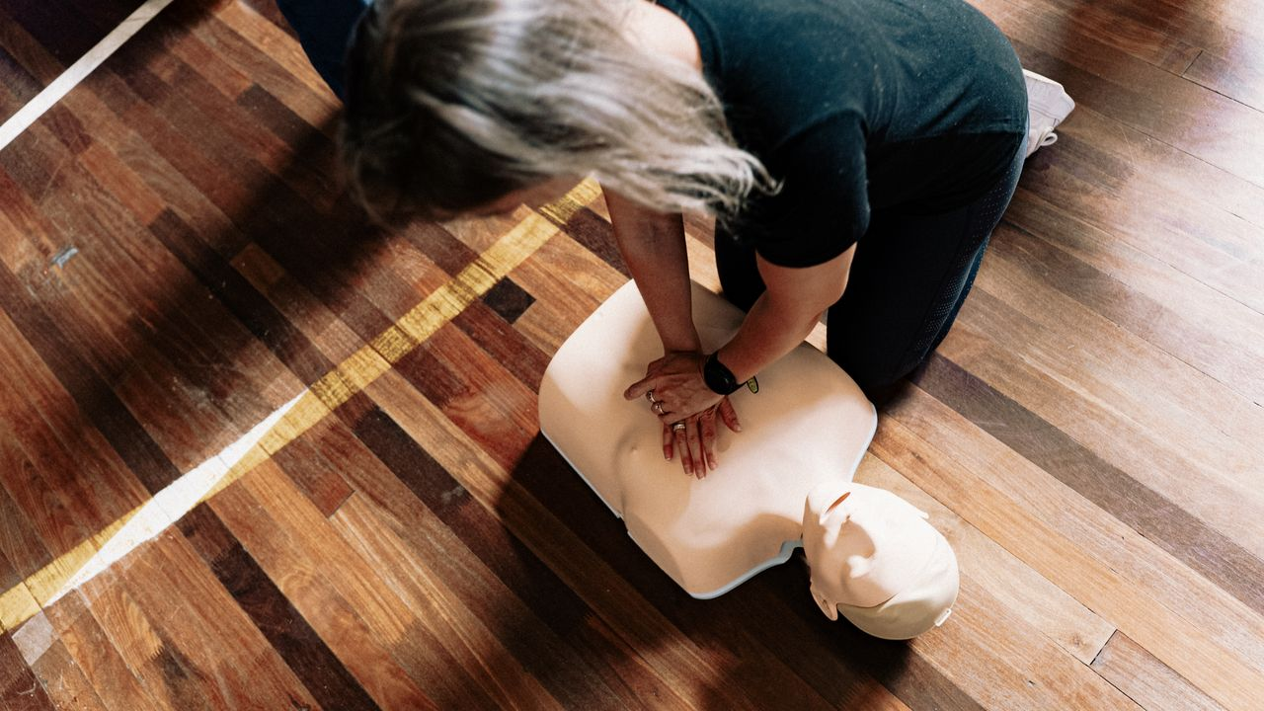
Be
a Helper!
Grades 4–6
Together For Health

Slide 2
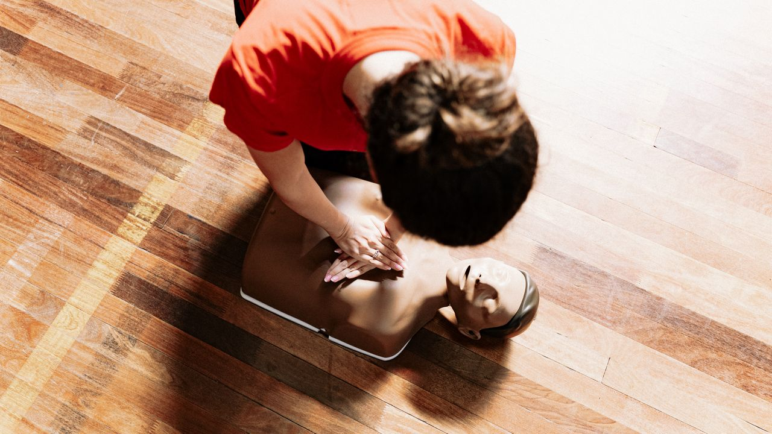
🫀
You Could Save a Life
Most cardiac arrests happen at home. The first person to help is usually a bystander.
Learning CPR as a kid makes you one of the most prepared people around.
Together For Health

Slide 3
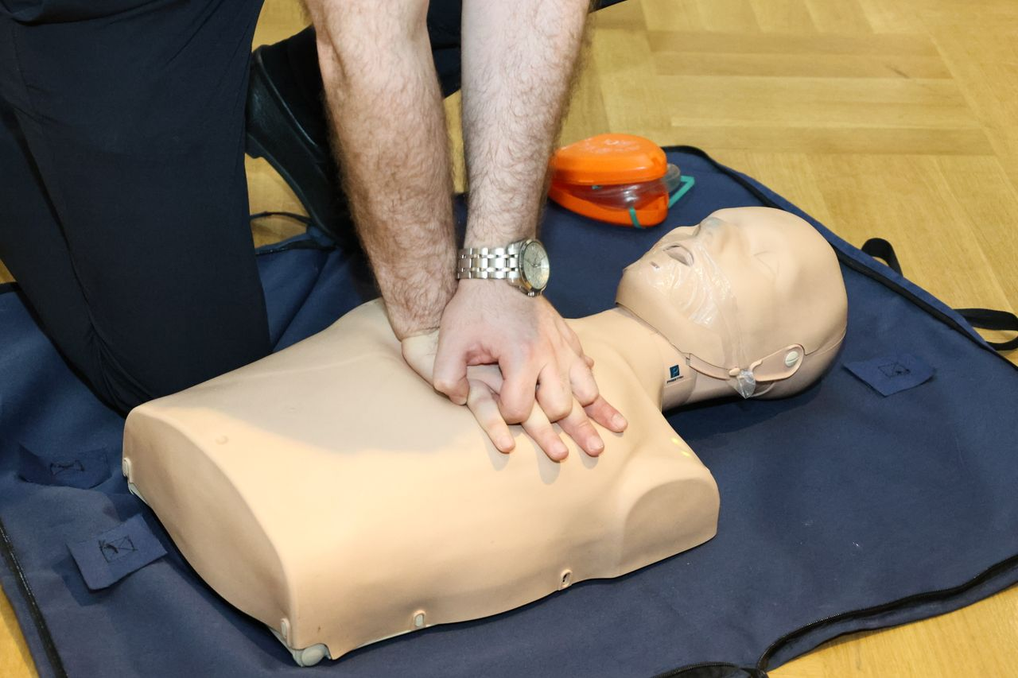
⚡
What Is CPR?
CPR stands for Cardiopulmonary Resuscitation
It is a way to keep blood and oxygen moving when someone's heart stops
Anyone can learn it — even kids!
Brain damage starts within 4–6 minutes without oxygen
CPR buys time until paramedics arrive
Together For Health

Slide 4
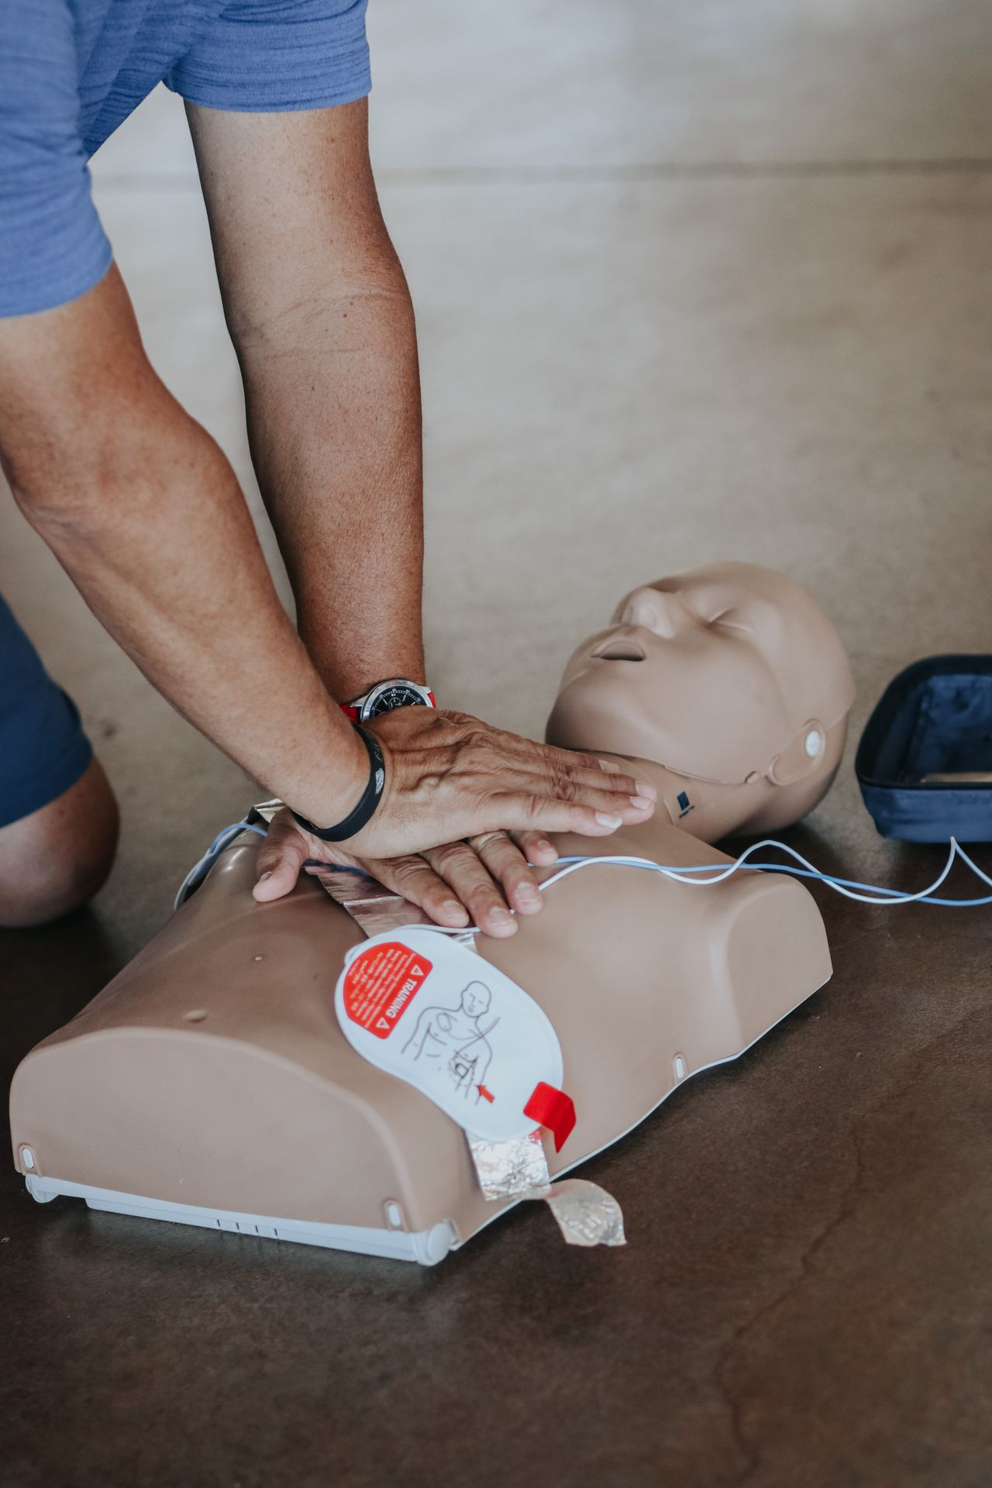
🫁
The 3 Steps of Basic CPR
CALL 9-1-1 first — tell them exactly where you are
1
PUSH hard on the centre of the chest — 30 times, fast
2
BREATHE — 2 rescue breaths into their mouth (or hands-only CPR)
3
Together For Health

Slide 5
💡
Hands-Only CPR — Anyone Can Do This
You do NOT have to do mouth-to-mouth breaths
Put your hands on the centre of the chest
Push down 5–6 cm (about 2 inches) — harder than you think!
Push 100–120 times per minute — the beat of "Stayin' Alive"
Keep going until help arrives or the person wakes up
Together For Health

Slide 6
KEY TAKEAWAYS
Calling 9-1-1 is always the first step
✓
You cannot make things worse by trying CPR
✓
You might be the reason someone's family member survives
✓
Resources
St. John Ambulance: sja.ca
Red Cross CPR course: redcross.ca
Ask your teacher about getting CPR certified!
Together For Health

